Slide 1
Locomotion and nutrition of animals
Semester: I
UNIT: 2
Movement and locomotion-Amoeboid movement-Ultrastructure of cilia and ciliary movements-Action of muscles. Nutrition-Types of nutrition: Autotrophic and heterotrophic. Apparatus for nutrition: Food Vacuole- Animals without alimentary canal-incomplete-complete-alimentary canal. Brief account of digestion in invertebrates
Presented By,
Dr. B. Vaseeharan
Professor & Head,
Department of Animal Health and Management, Alagappa University, Karaikudi

Slide 2
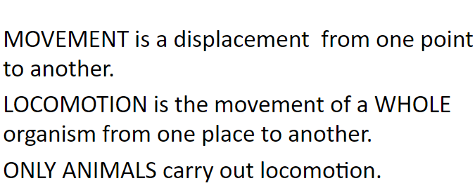
MOVEMENT AND LOCOMOTION

Slide 3
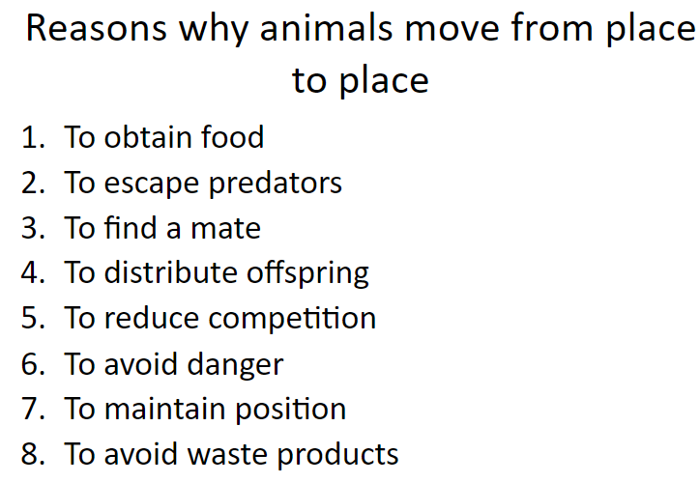

Slide 4
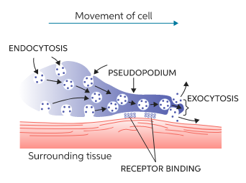
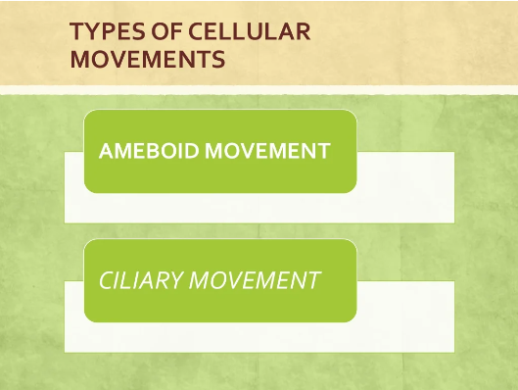
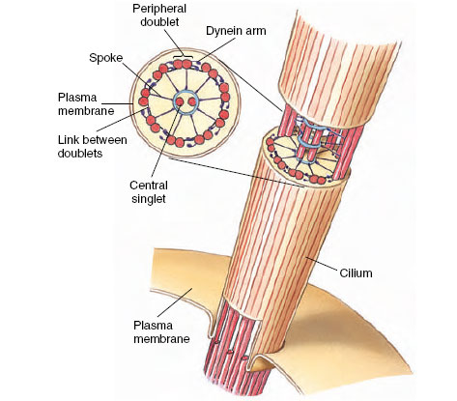

Slide 5
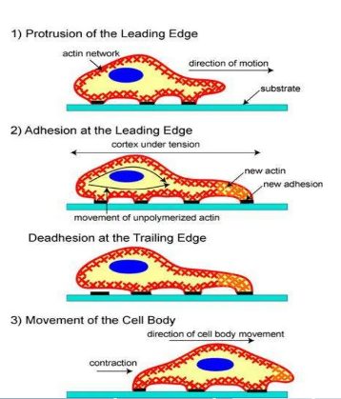
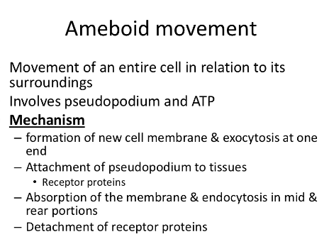
AMOEBOID AND CILIARY MOVEMENT

Slide 6
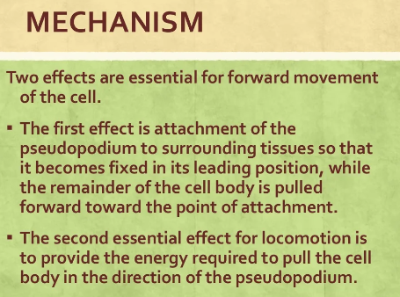
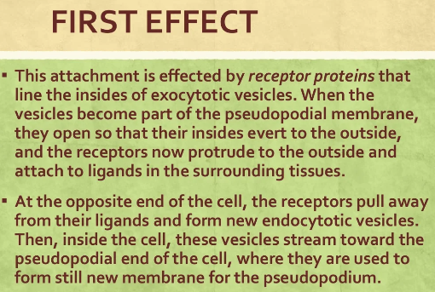

Slide 7
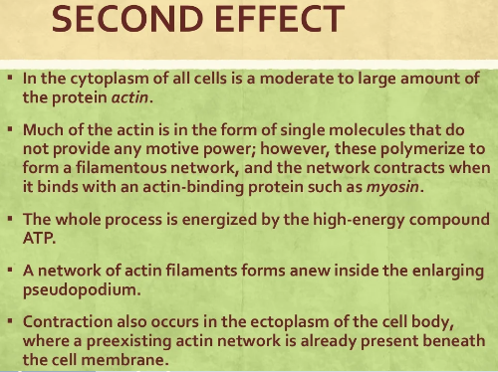
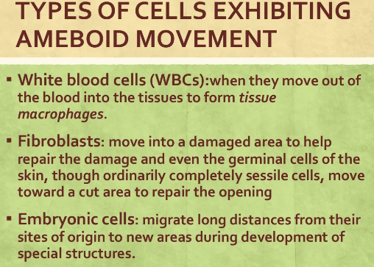

Slide 8
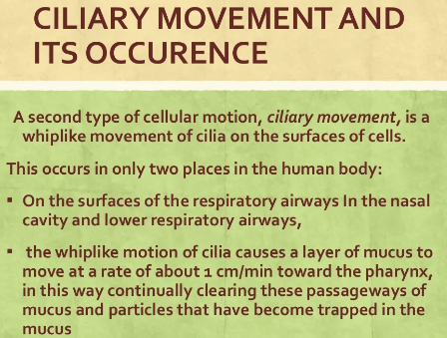
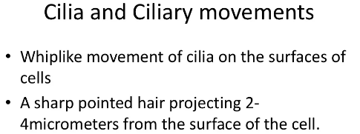
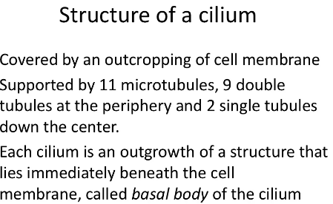

Slide 9
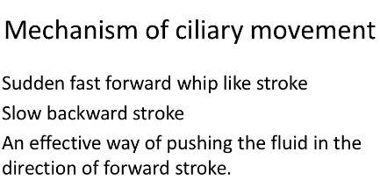
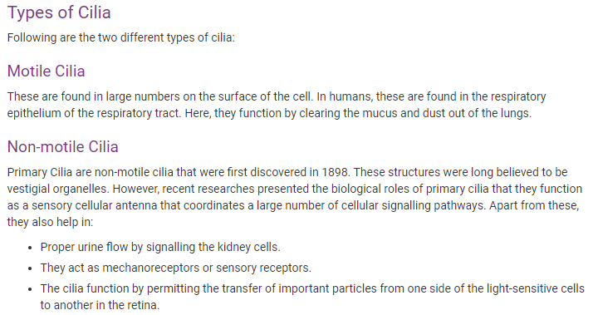
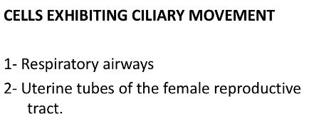

Slide 10
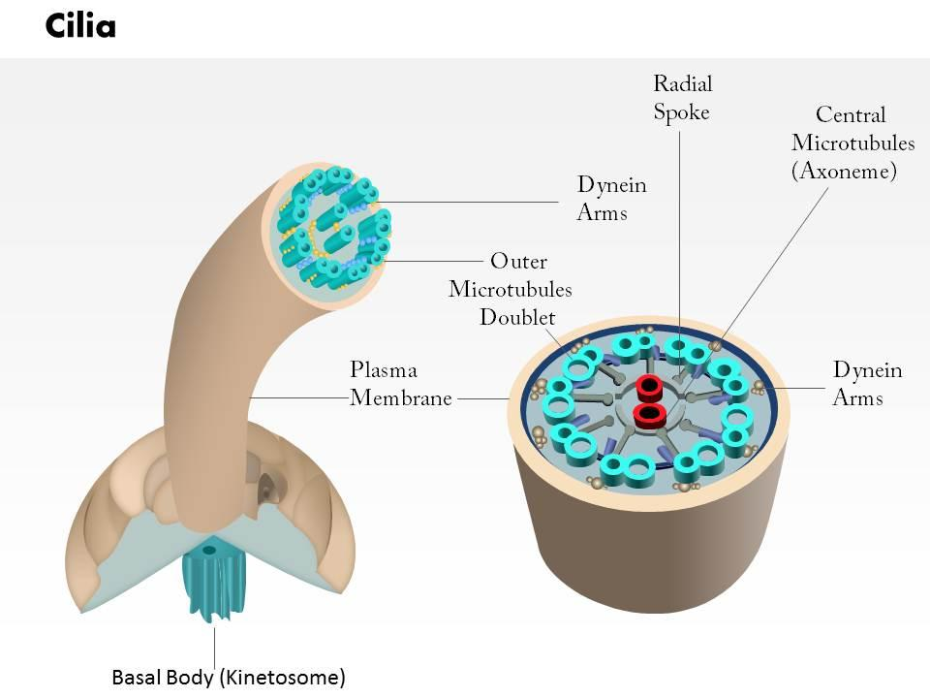
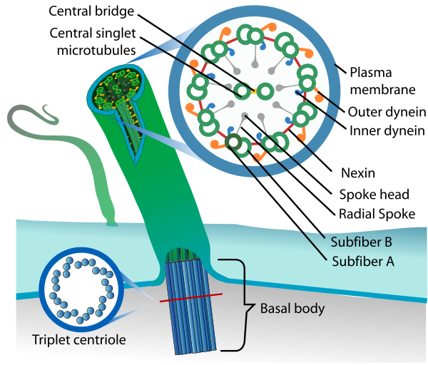

Slide 11
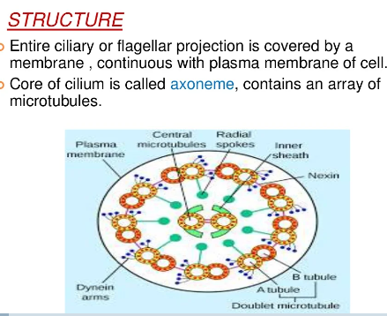
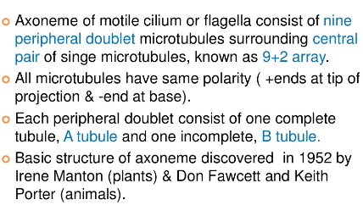
ULTRA STRUCTURE OF CILIA

Slide 12
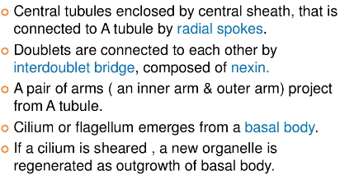
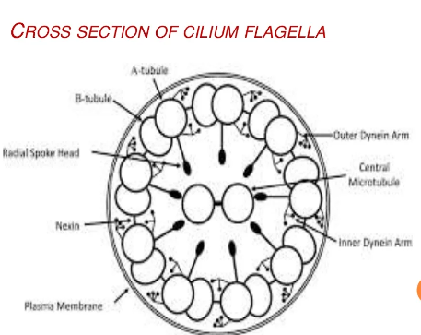

Slide 13
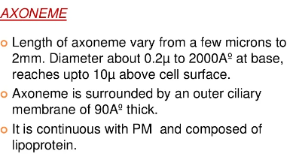
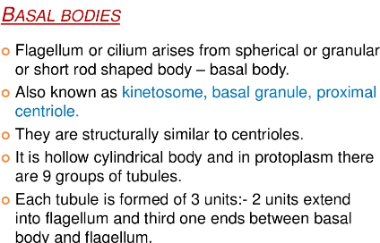
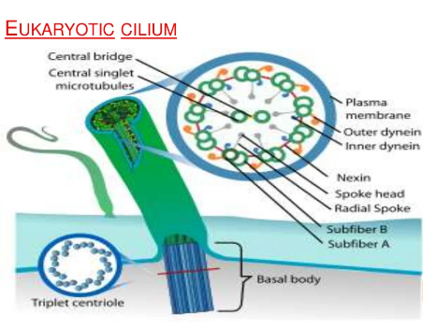

Slide 14
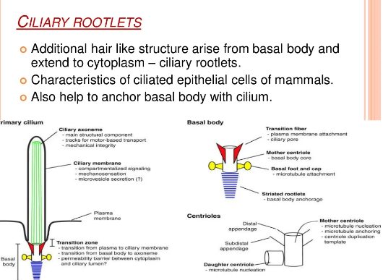

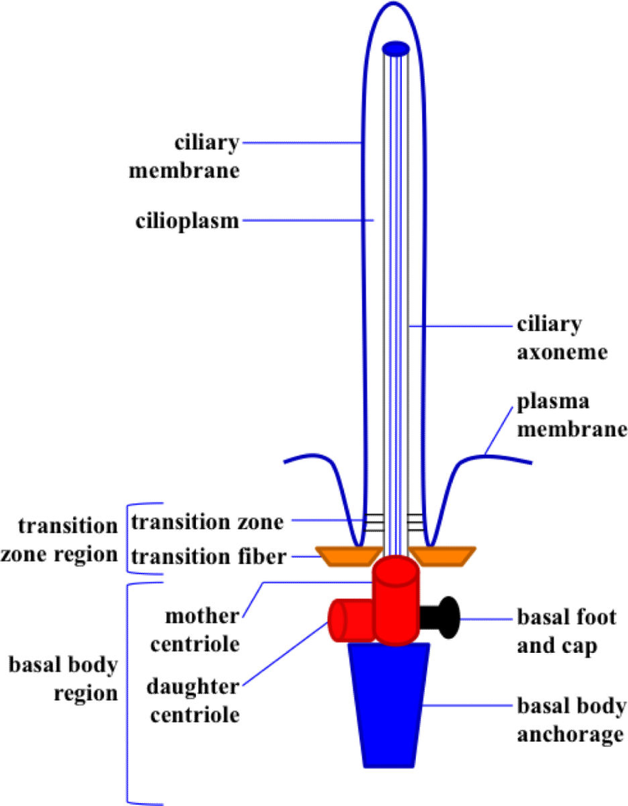
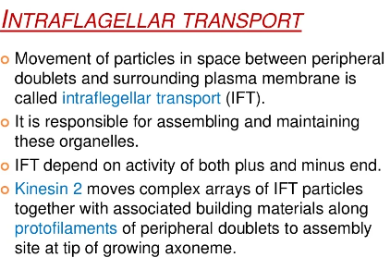

Slide 15
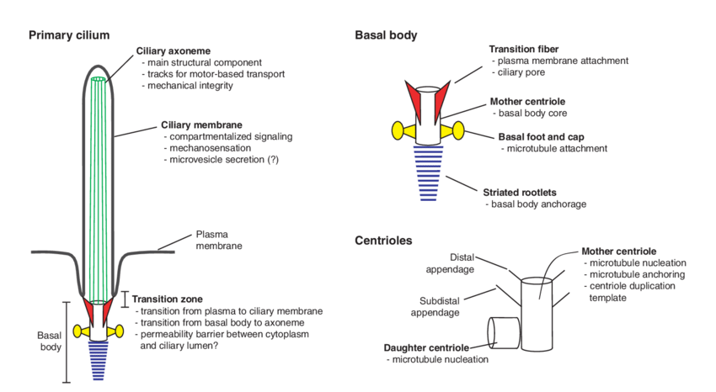

Slide 16
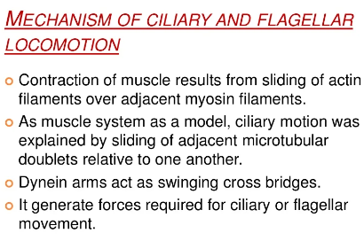
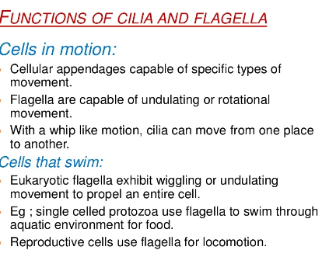
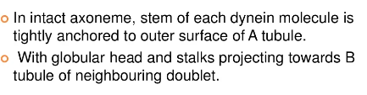

Slide 17
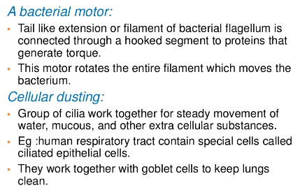
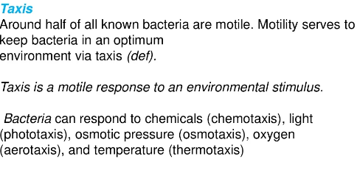
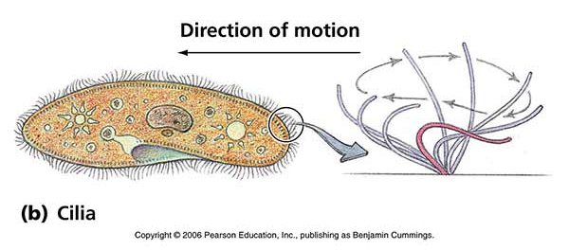

Slide 18
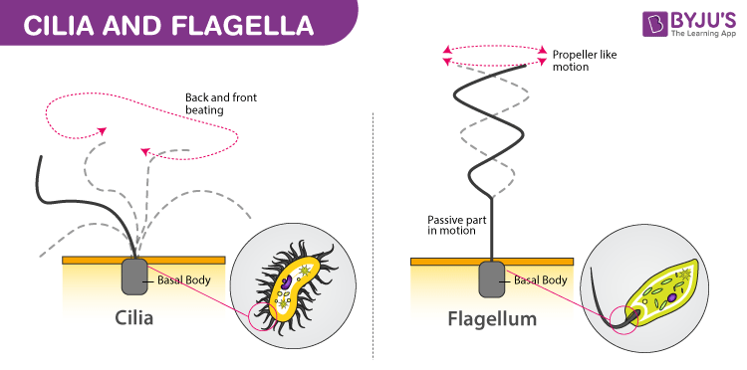
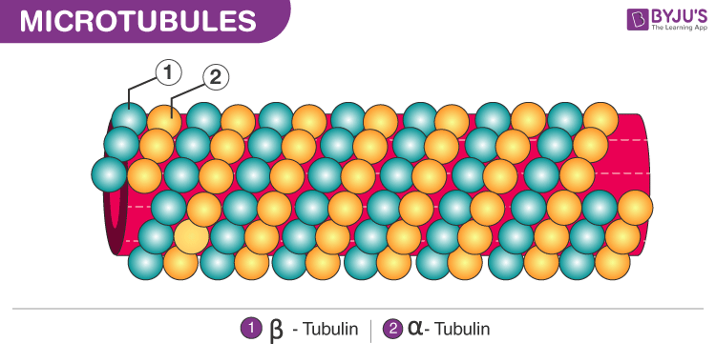
CILIARY MOVEMENTS
Ciliary movement refers to the rhythmic movement of cilia, which causes movement of the fluid or the cell. E.g. in Paramecium, ciliary movement helps in the movement of the cell as well as in the movement of the food inside the cell. Cilia are present in the epithelial lining such as the fallopian tube, respiratory tract, where they help in the movement of fluid as well as trap any external particles in the mucus.

Slide 19
ACTION OF MUSCLES
The muscular cells of invertebrates can be divided into three major classes on the basis of their striation pattern: transversely striated, obliquely striated, or smooth muscle.
Transversely striated muscles have either continuous or discontinuous Z lines and, thus, can be subdivided into two types respectively.
Of all invertebrate muscles, the transversely striated muscle with continuous Z lines is the most similar to the vertebrate skeletal muscle and is present in arthropods, whose musculature (including the visceral muscles) only consists of this cell type. These muscles are multinucleate cells that contain myofibrils showing well-defined sarcomeres.
Transversely striated muscles with discontinuous Z lines, consisting of multiple small electron dense patches, are found in the translucent portions of adductor muscles of some bivalves and in the heart muscle of the gastropods. This muscle is formed by mononucleated cells with centrally-located nuclei and a single myofibril.

Slide 20
The obliquely striated muscle appears in nematodes, annelids, molluscs, brachiopods and chaetognathes and consists of mononucleated cells with both thick and thin myofilaments which form sarcomeres delimited by Z lines.
The thick (myosin) myofilaments show a variable length (from 2.2 microns up to 6 microns) and width (from 14 nm up to 231 nm) and contain a central core of paramyosin, which is absent in vertebrate muscles. Thick filaments are homogenous in transversely striated muscles and either homogeneous or fusiform in the obliquely striated and smooth muscles.
Thin filaments measure 6 nm in diameter. They contain tropomyosin and, only in striated muscles, also troponin. The thin/thick filament ratio varies from 3/1 to 6/1, even in smooth muscles. The plaques for filament anchorage (Z lines in striated muscles or electron dense bodies in smooth muscles) contain alpha-actinin. The striated (transversely or obliquely) muscles show long sarcomeres (up to 9 microns) and the number of thin filaments around each thick filament varies from 3 to 12, so that each thin filament is shared by two thick filaments. .

Slide 21
Many striated muscles contain titin (connectin) and intermediate filaments and display a sarcotubular system consisting of T tubules and sarcoplasmic reticulum tubules. Both structures form dyads and, more rarely, triads.
The location of T tubules as well as the configuration and distribution of sarcoplasmic reticulum vary among muscles and species. Invertebrate smooth muscle differs from that of vertebrates principally in the higher proportion and larger diameter of thick myofilaments.
These may be fusiform and their size and number may vary widely among cells. These muscle cells may be classified by the characteristics of both the thick filaments and the electron dense bodies for filament anchorage.

Slide 22
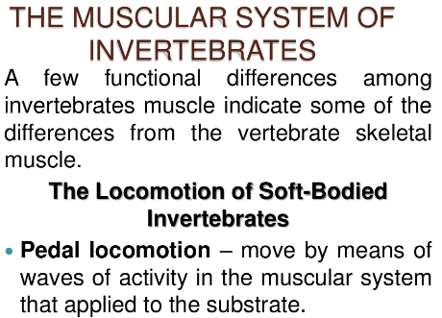
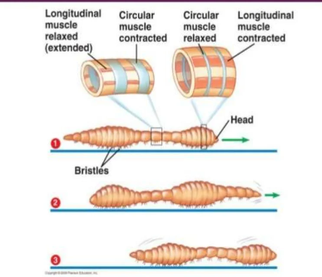
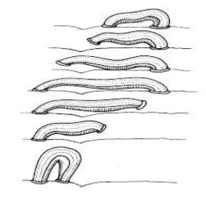
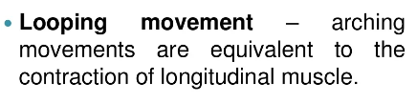

Slide 23
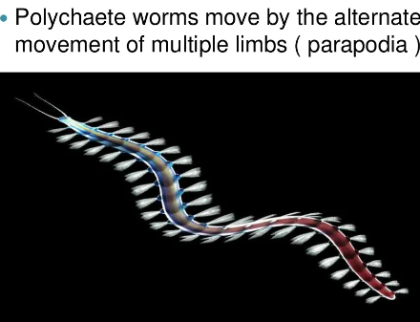
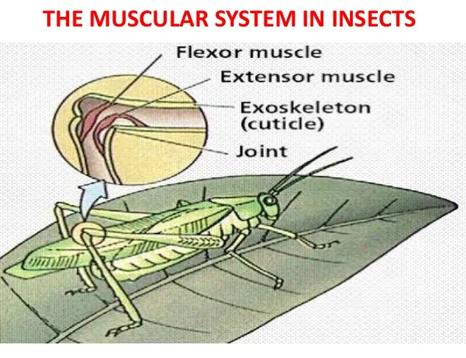
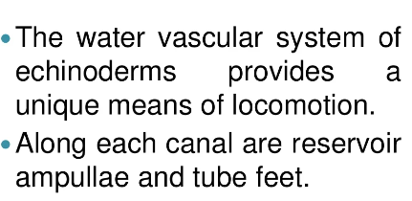

Slide 24
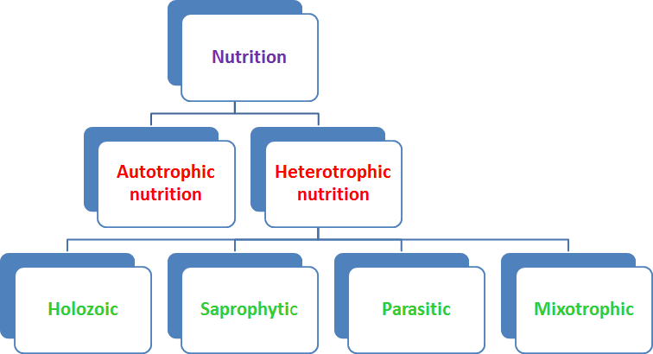
NUTRITION
Nutrition is the biochemical and physiological process by which an organism uses food to support its life. It provides organisms with nutrients, which can be metabolized to create energy and chemical structures.
TYPES OF NUTRITION

Slide 25
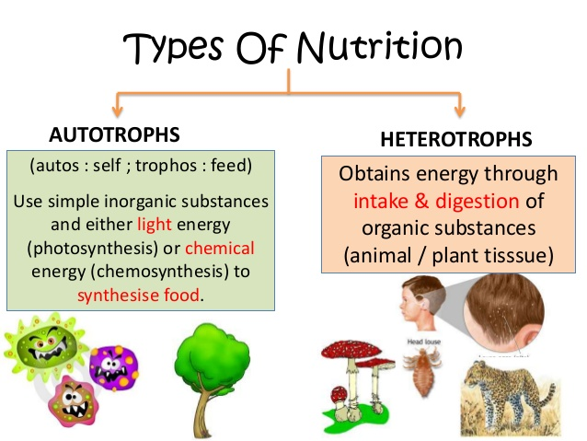
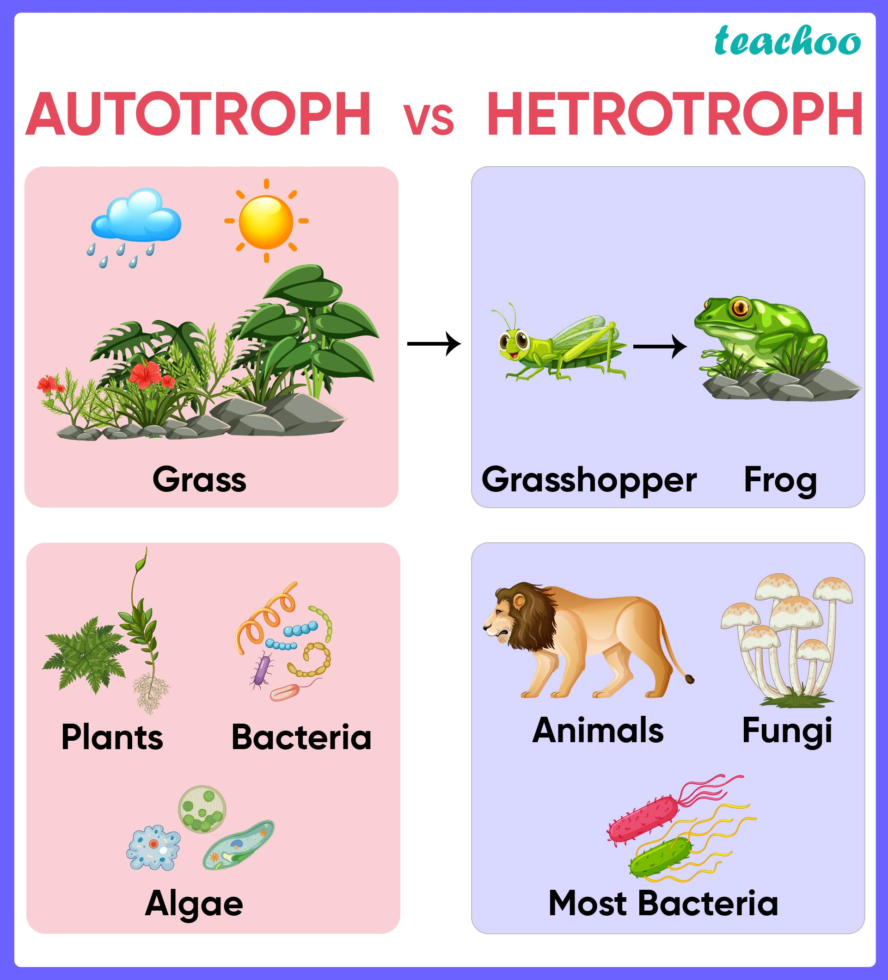

Slide 26
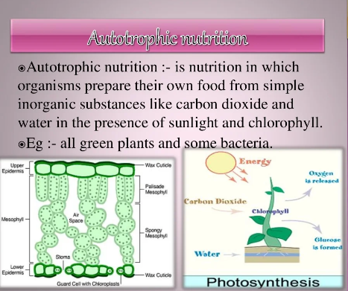
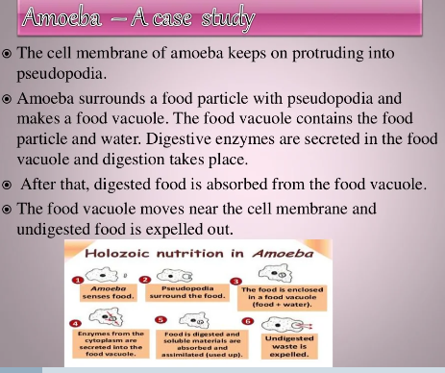

Slide 27



Slide 28



Slide 29



Slide 30



Slide 31


Slide 32

APPARATUS FOR NUTRITION
FOOD VACULOE

Slide 33


Food vacuoles are formed as a result of the fusion of lysosomes and phagosomes. They perform different kinds of functions such as ingestion, storage, and excretion of excess water. It is mainly present in unicellular protozoans which includes plasmodium, amoeba, etc. In biology, a vacuole is termed as a space in a cell that is fully empty of cytoplasm. It is a lined membrane filled with fluid. Vacuoles are usually cytoplasmic organs. In-plant cells large central vacuoles are found. It enables them to attain a large size without accumulating bulk, which makes metabolism difficult.

Slide 34
Structure of Food Vacuole
Food Vacuoles have no specific or basic size or shape. Food Vacuole’s structure varies according to the need and requirements of the cells.
In the actively dividing and immature plant cells these vacuoles are quite small. They arise priorly in young dividing cells, generally by progressive fusion of vesicles which are derived from Golgi apparatus.
The vacuole is surrounded by a cell membrane which is called a vacuolar or tonoplast membrane which is filled with the sap of the cell.
Every vacuole is segregated from the cytoplasm with a single unit membrane which is called the Tonoplast. Tonoplast is a cytoplasmic membrane. It separates the vacuolar contents of the cytoplasm from the cells. These vacuoles are functionally and structurally linked to lysosomes in animal cells and they may contain a range of hydrolytic enzymes.
The plant vacuoles' pH may be as high as 10 because of large quantities of alkaline particles and substances or low to 3 because of accumulation of acids.

Slide 35
Types of Vacuole
Sap Vacuoles
These are those types of vacuoles that have several transport systems to pass the different substances. Numerous small sap vacuoles are there in animal and young plant cells. In some mature plants, small vacuoles fuse to form a single large central vacuole. It occupies around 90% of the cell. The central vacuole spreads the cytoplasm of a thin peripheral layer. It facilitates rapid exchange and the surrounding environment.
Contractile Vacuoles
These are those kinds of vacuoles that occur in some algae and protist cells which are found mostly in freshwater. These are those types of contractile vacuoles which have a highly collapsible and expandable membrane. These are also connected to a few canals which are for feeding. These canals have water with or without waste products from the cytoplasm surrounding them. It pours the same into the vacuole of the contractile.

Slide 36



Slide 37
Food Vacuoles
These kinds of vacuoles are present in protozoan protists cells, in several lower animals, and phagocytes of higher animals. These are formed by the fusion of a lysosome and a phagosome. It has digestive enzymes with which the nutrients are digested. Then these digested materials pass out into the cytoplasm’s surroundings.
Air Vacuoles (Gas Vacuoles, Pseudo-Vacuoles)
These kinds of vacuoles are found only in Prokaryotes. This vacuole is not just a single entity, and it is as such surrounded by a common membrane. It has numerous numbers of sub-microscopic vesicles. In this, every vesicle is the one that is surrounded by a membrane of protein and encloses metabolic gases. It does not only store gases but also provides mechanical strength, buoyancy, and protection from harmful radiations.

Slide 38
Functions of Food Vacuole
Food vacuoles contain an enzyme called hydrolyzing enzyme which helps in the digestion of food.
The cell membrane forms a curve to allow the passage of food particles, when the food is captured completely inside the membrane it pushes into the cell.
Food vacuole performs the metabolic function in a way that succulent plants open their stomata and take the carbon dioxide from the atmosphere at night. This will be converted then to malic acid and stored in vacuoles until the next day. In the daytime, light energy can be used to convert it to sugar.
They also perform homeostatic functions in cells of plants that are subjected to wide variations in the environment.
Molecules can be stored in plant vacuoles and act as a storage organelle for both nutrients and waste products.
They also perform functions in fungal cells which include the homeostasis of cell pH and storing of amino acids. In animal cells, they tend to perform by helping in exocytosis and endocytosis.
Food vacuoles allow the organs or germinating plants to grow fastly because of the increase in size.

Slide 39


COMPLETE AND INCOMPLETE ALIMENTARY CANAL
Animals have evolved different types of digestive systems to break down the different types of food they consume. Invertebrates can be classified as those that use intracellular digestion and those with extracellular digestion.
Intracellular Digestion
The simplest example of digestion intracellular digestion, which takes place in a gastrovascular cavity with only one opening. Most animals with soft bodies use this type of digestion, including Platyhelminthes (flatworms), Ctenophora (comb jellies), and Cnidaria (coral, jelly fish, and sea anemones). The gastrovascular cavities of these organisms contain one open which serves as both a “mouth” and an “anus”.

Slide 40
Extracellular Digestion
The alimentary canal is a more advanced digestive system than a gastrovascular cavity and carries out extracellular digestion. Most other invertebrates like segmented worms (earthworms), arthropods (grasshoppers), and arachnids (spiders) have alimentary canals. The alimentary canal is compartmentalized for different digestive functions and consists of one tube with a mouth at one end and an anus at the other.
Once the food is ingested through the mouth, it passes through the esophagus and is stored in an organ called the crop; then it passes into the gizzard where it is churned and digested. From the gizzard, the food passes through the intestine and nutrients are absorbed. Because the food has been broken down exterior to the cells, this type of digestion is called extracellular digestion. The material that the organism cannot digest is eliminated as feces, called castings, through the anus. Most invertebrates use some form of extracellular digestion to break down their food. Flatworms and cnidarians, however, can use both types of digestion to break down their food.

Slide 41


Slide 42


Slide 43
PHYSIOLOGY OF DIGESTION IN INVERTEBRATES
Digestion by invertebrates is nominally in two phases: extracellular breakdown of food followed by intracellular digestion; protist invertebrates digest foodstuffs by intracellular means. Invertebrate digestion differs from that of vertebrates in that the former lacks digestive glands opening into the hindgut.
Feeding in Invertebrates:
There are various mechanical processes by which invertebrates capture food. The processes are developed in accordance to various kinds of food that a given animal can obtain and utilize.
i. Microphagy:
These are mechanisms for dealing with small food particles. In this process pseudopodia, cilia, tentacles, mucus, setae and muscles are used for obtaining food.
ii. Macrophagy:
These are mechanisms for dealing with large food particles or masses. This involves swallowing of inactive food, scraping, boring, and seizing the prey.

Slide 44
iii. Fluid or Soft Tissue Feeding:
These type of feeders generally suck fluid food. Some pierce and then suck the body fluid of the prey and some simply absorb the liquid food from the substrate through body surface.
Digestive processes, particularly in macrophagous animals, are both mechanical and chemical
i. Mechanical Digestion:
This is achieved with the help of the different compo­nents of the mouth parts and different specialised parts of the digestive tracts. In this process large mass of the prey are crushed into smaller parts mechanically.
ii. Chemical Digestion:
In this process smaller masses of prey are broken into simpler organic compounds with the help of different hydrolytic enzymes. The site of enzymatic action varies within the animal body.

Slide 45
According to the site of enzymatic action, chemical digestion is of two types:
(a) Intracellular Digestion:
Here diges­tion takes place within the cell. The protoplasm of the unicellular animal captures the food, encircles it in a food vacuole, digests it, discharges the wastes and incorporates the digested simple organic components into the protoplasm.
(b) Extracellular Digestion:
Here diges­tion takes place outside the cell and generally within the digestive tract of the higher animals. Digestion is wholly intracellular in Protozoa and Porifera. In other phyla extra­cellular digestion either supplements the intracellular mechanisms or completely replaces it. In the following discussion we shall describe the process of feeding and digestion in some invertebrates.
Example: Amoeba

Slide 46
Microphagy in Amoeba:
Amoeba is a member of Phylum-Sarcodina of Sub-kingdom-Protozoa. They are unicellular organisms and are present in marine, fresh water and terresterial habitats. They are entirely heterotrophic. Their food consists of all types of small organisms like bacteria, algae, diatoms, protozoans, and even small multicellular animals, such as rotifers, copepod larvae and nematodes.
Process of Feeding:
Amoeba as a non- ciliate and non-flagellate organism is wholly dependent on its membrane for food intake. The cell membrane acts according to the quality of the food to be consumed.
Permeation
The semi-permeable cell membrane receives the small organic molecules, salts, ions and other molecules in two ways.
Passive Diffusion
In this process the soluble materials like sugars, amino acids etc. diffuse to the concentration gradient and move into the less con­centrated protoplasm from the highly concentrated surrounding.

Slide 47
Active Transport:
The protein channels of the cell membrane function as ener­gy-requiring pumps, actively trans­porting certain molecules or moving ions in or out against their concentra­tion gradient.
Endocytosis:
In this process extracellu­lar materials enter the cell with the invagination of the cell membrane. The invaginated portion ultimately pinches off internally to form food vesicles. There are two basic types of endocytosis — specific and non-specific.
Specific Endocytosis or Receptor Mediated Endocytosis
This process brings in proteins and other macromolecules at a faster rate than predicted by con­centration gradient. These substances bind to the specific membrane recep­tors before they are taken into the vesicles
Non-specific Endocytosis
Any types of dissolved or floating organic materials are taken in by this process. According to the nature of food this process is divided into two types – pinocytosis and phagocytosis.

Slide 48
Pinocytosis in Invertebrates:
Water, ions and small molecules of sugar and protein are absorbed by this process. In this process the cell mem­brane invaginates into the cytoplasm. The dissolved food with water enters into the invaginated portions. The rate of uptake is in simple proportion to the external concentra­tion of the material being absorbed. The invaginated pit is then pinched off
Phagocytosis in Invertebrates
This is the process of engulfment of large particles, such as bacte­ria, protozoans etc. In this process multiple membrane receptors work synchronously to capture a large mass of food. Dynamic alte­ration of the cell membrane and cytoplasmic elements help to seize the prey
Process of Digestion in Invertebrates
In Amoeba, inges­ted food occupies a vesicle, called food vacuole, in the protoplasm. The food vacuole initially contains both food and fluid. At the beginning, food vacuoles decrease in size due to diffusion of fluid out­wards into the cytoplasm. At this stage, the acidity of the vacuole is nearly at a pH of 5.6. This acidity helps in the death of prey.

Slide 49

After that, the pH of the vacuole increases to about 7.3. This is due to the inflow of fluids from the lysosomes. Lysosomes come in contact with the food vacuole, fuse with it and release its contents within the food vacuole. The lysosomal fluid contains hydrolytic enzymes. These enzymes perform the digestion of the killed prey until there remains only a small residue of un-digestible material. The products of diges­tion diffuses from the vacuole into the cyto­plasm of the cell where they may be used in metabolism by other organelles or stored after undergoing synthesis, into other forms, such as glycogen and lipid. The undigested material is discarded from the body by exocytosis.

Slide 50



Slide 51


