Slide 1
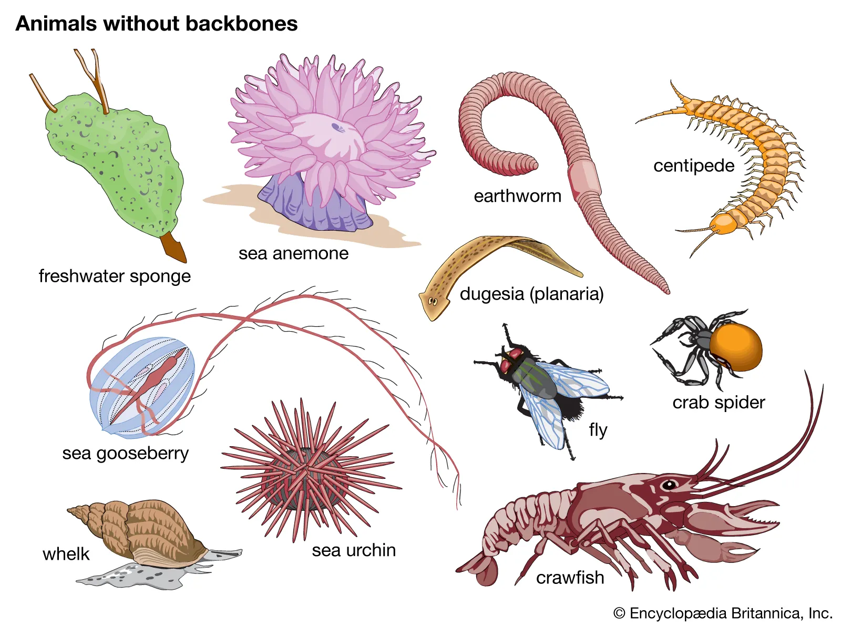
structure and functions of invertebrates
Semester: I
UNIT: I
Presented By,
Dr. B. Vaseeharan
Professor & Head,
Department of Animal Health and Management, Alagappa University, Karaikudi

Slide 2
unit-I
Diversity of animal kingdom
Diversity of Animal kingdom: Linnaeus and the origin of classification, taxonomic characters and reconstruction of phylogeny, Levels of organization-Unicellularity-multicellularity, Colonization and organization of germ layers-Division of labour and organization of tissues-ectoderm, mesoderm and endoderm-Development of Acoelomate organization-symmetry-symmetry-segmentation and cephalization
animal DIVERSITY
Animal diversity represents the fundamental structural differences between groups of organisms; adaptive diversity represents the smaller differences between species as a result of habitat specialization

Slide 3
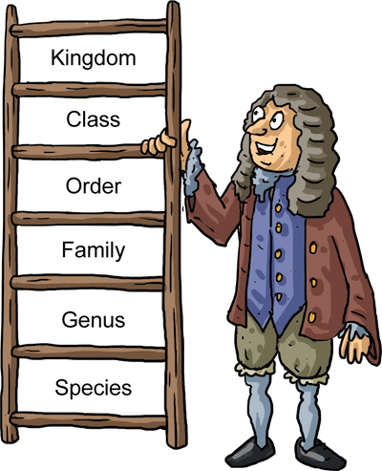
Classification of Living Things
Scientists estimate that there are between 3 million and 100 million species of organisms on Earth.
Taxonomists--biologists who specialize in identifying and classifying life on our planet--have named approximately 1.7 million species so far.
Each year, about 13,000 new species are added to the list of known organisms.
So, how do scientists classify (organize) all these millions of species?

Slide 4
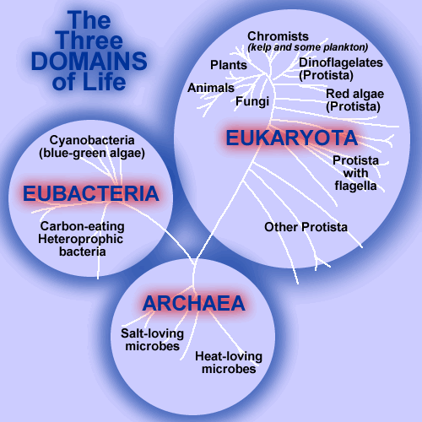
3 Domains and 4 Kingdoms
2 Types of Cells
EUKARYOTES
organisms with a nuclear membrane
PROKARYOTES
organisms with no nuclear membrane

Slide 5
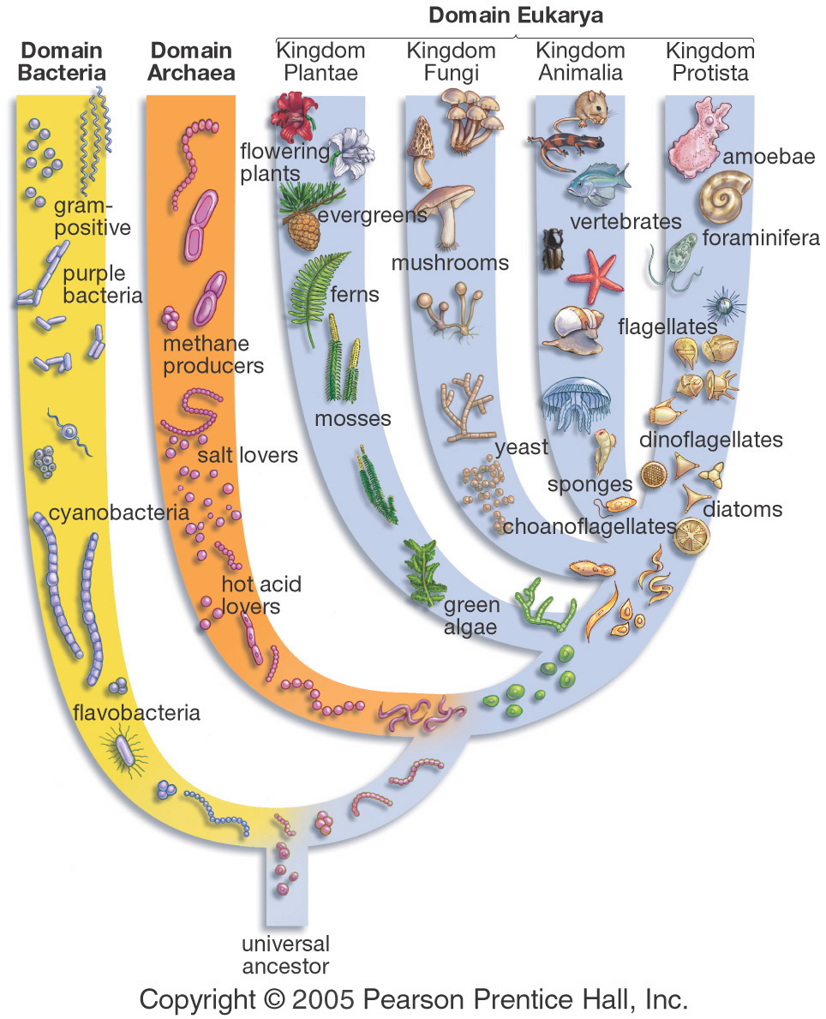
The Big
Picture

Slide 6
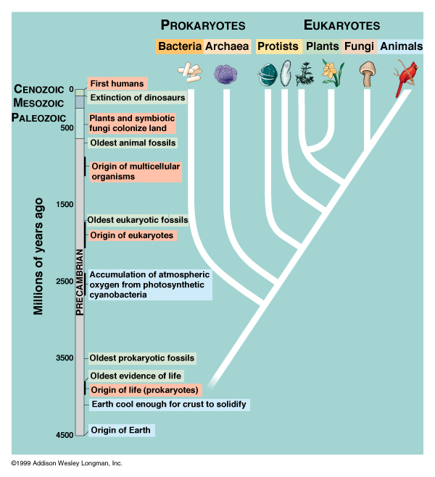
The History of Life on Earth
Multicellular eukaryotes (with nuclear membrane) evolved about 1 billion years ago.
For 2.6 billion years, life was unicellular.
Life began on Earth 3.6 billion years ago as a prokaryotic cell (single-celled organism with no nuclear membrane).
The Earth formed 4.5 billion years ago.

Slide 7
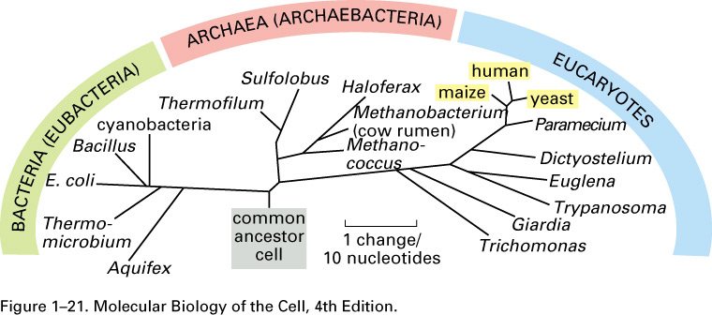
Life’s History and Diversity
Line length reflects evolutionary distance.
Note the close spacing of the groups plants (maize), fungi (yeast) and animals (humans).
We’ve got a lot more in common with bacteria and plants than we think!

Slide 8
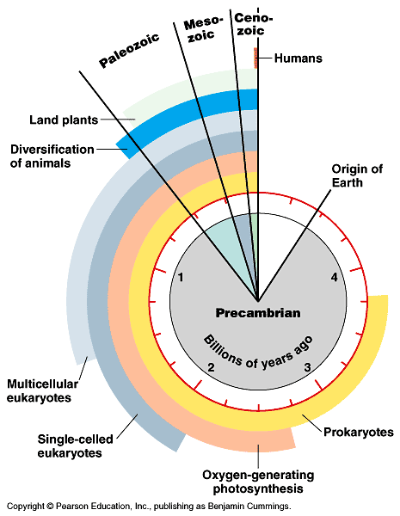
Life’s History
Animals diversified in the ocean about 600 million years ago.
Plants colonized land about 440 million years ago and were followed shortly by animals.
Humans of any sort are a very recent evolutionary development (~ 7 million years ago).

Slide 9
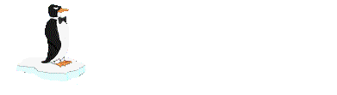

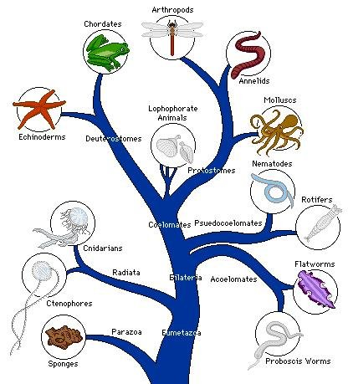
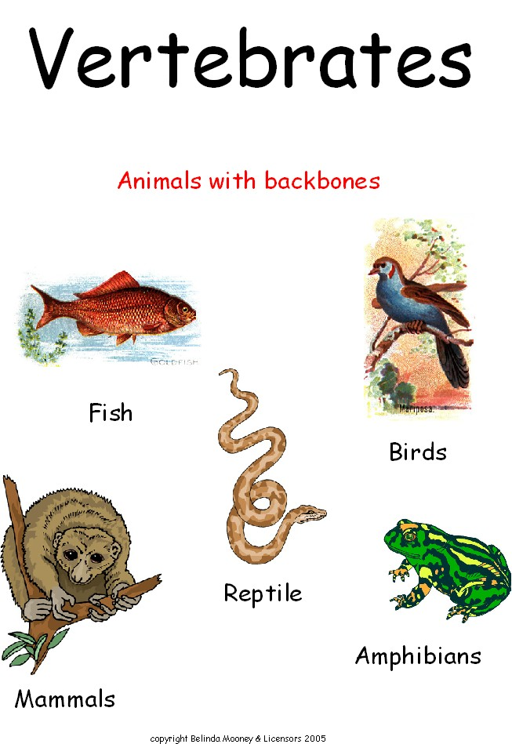
ANIMALS
Invertebrates (no backbone)
Vertebrates (backbone)

Slide 10
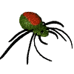
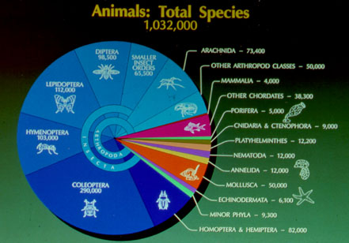
As you can see, we mammals (4000 species) are far outnumbered by the other vertebrates, or chordates (38,300). And vertebrates (42,300) are definitely outnumbered by invertebrates (989,700 species). The biggest categories of invertebrates: INSECTS!

Slide 11
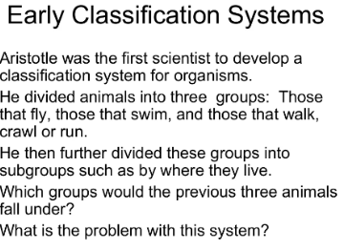
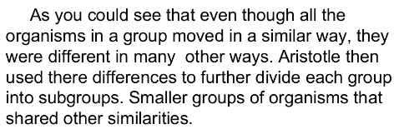
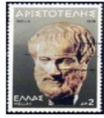
Why Classify?
To make it easier to study life!
Taxonomy- the assigning of a universally accepted name to a species.
Binomial nomenclature- An organism’s classification is based on its Genus and species names. The Genus is ALWAYS capitalized, and the species name is NEVER capitalized.
E.g. Homo sapiens (humans), Odocoileus virginianus (White tailed deer)

Slide 12
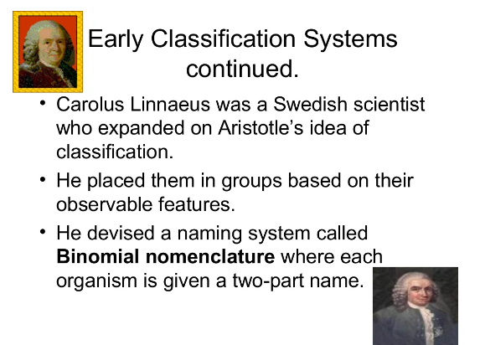
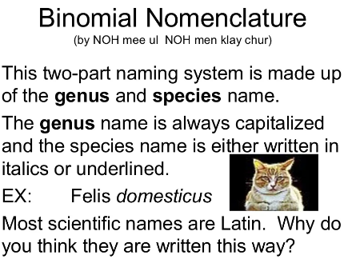
Linnaeus
We use a system today that was originally created by Carl Linnaeus. Linnaeus- (1707-1778) A botanist who created a classification system of organisms based on their physical similarities with each other. Originally, Linnaeus only had two Kingdoms, or major categories-Plant and Animal.

Slide 13
LINNAEUS AND THE ORIGIN OF CLASSIFICATION
Carolus Linneaus (1707-1778) was a Swedish doctor, botanist, and explorer who extensively studied taxonomy, which is the study of the names and classifications of living organisms. He made two major contributions to the subject, namely the Linnaean Classification System and the binomial system of naming species. These systems of Linnaean taxonomy continue to be used for classifications of newly discovered species today.
All modern classification systems have their roots in the Linnaean classification system. It was developed by Swedish botanist Carolus Linnaeus in the 1700s. He tried to classify all living things that were known at his time. He grouped together organisms that shared obvious physical traits, such as number of legs or shape of leaves. For his contribution, Linnaeus is known as the “father of taxonomy.”

Slide 14
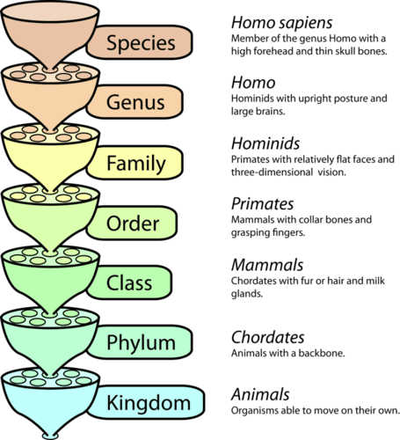
The Linnaean system of classification consists of a hierarchy of groupings, called taxa (singular, taxon). Taxa range from the kingdom to the species. The kingdom is the largest and most inclusive grouping. It consists of organisms that share just a few basic similarities. Examples are the plant and animal kingdoms. The species is the smallest and most exclusive grouping. It consists of organisms that are similar enough to produce fertile offspring together. Closely related species are grouped together in a genus.

Slide 15
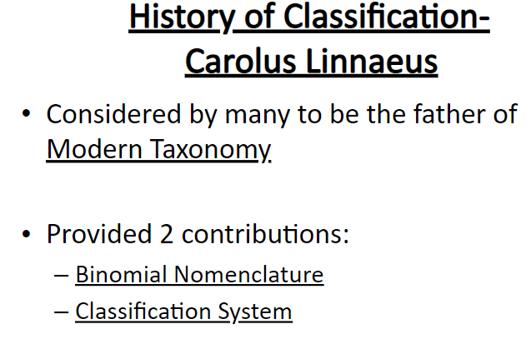
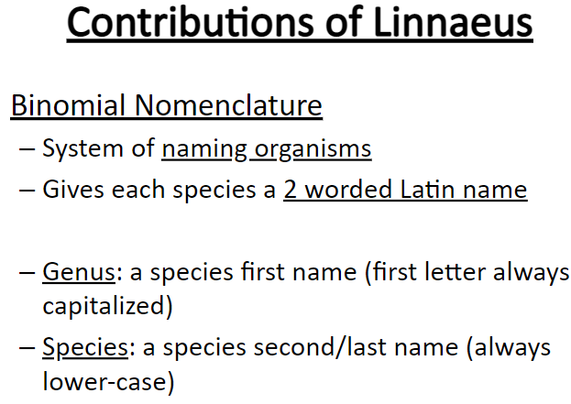

Slide 16
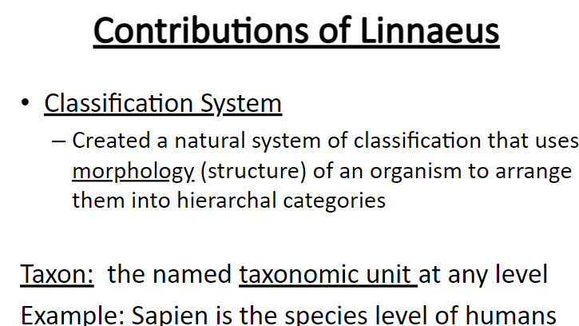
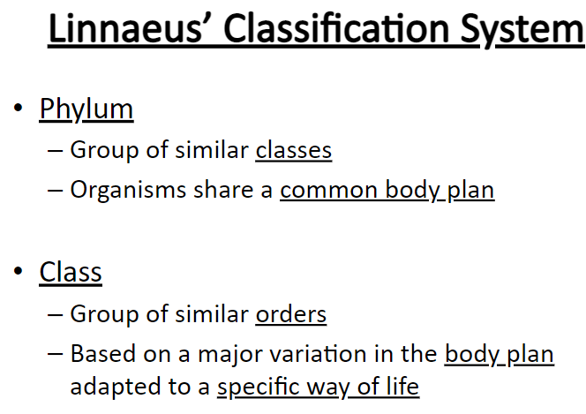

Slide 17
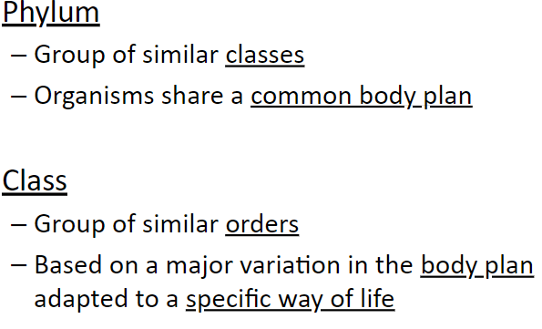
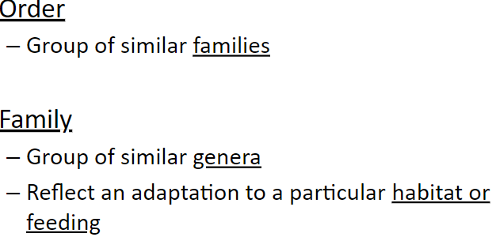

Slide 18
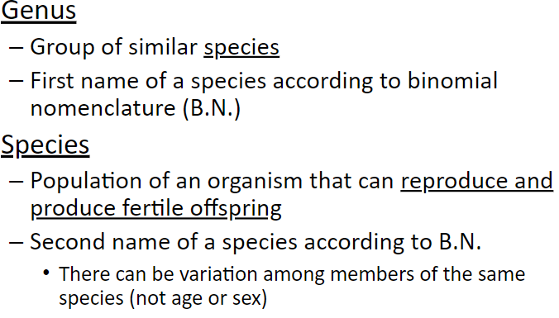
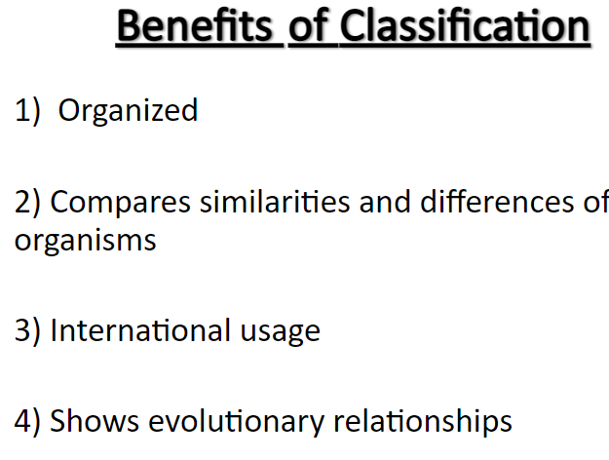

Slide 19
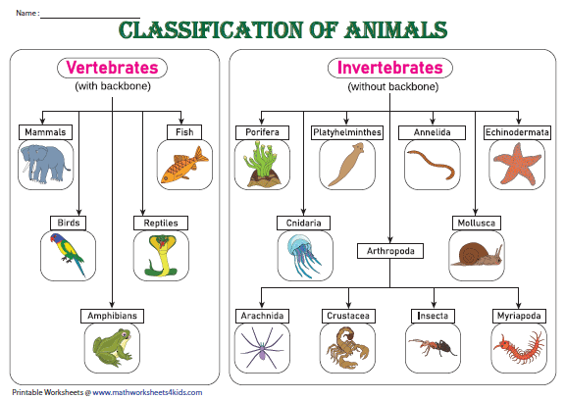
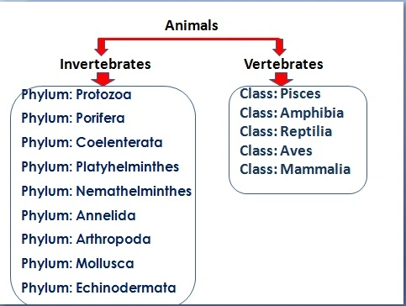

Slide 20
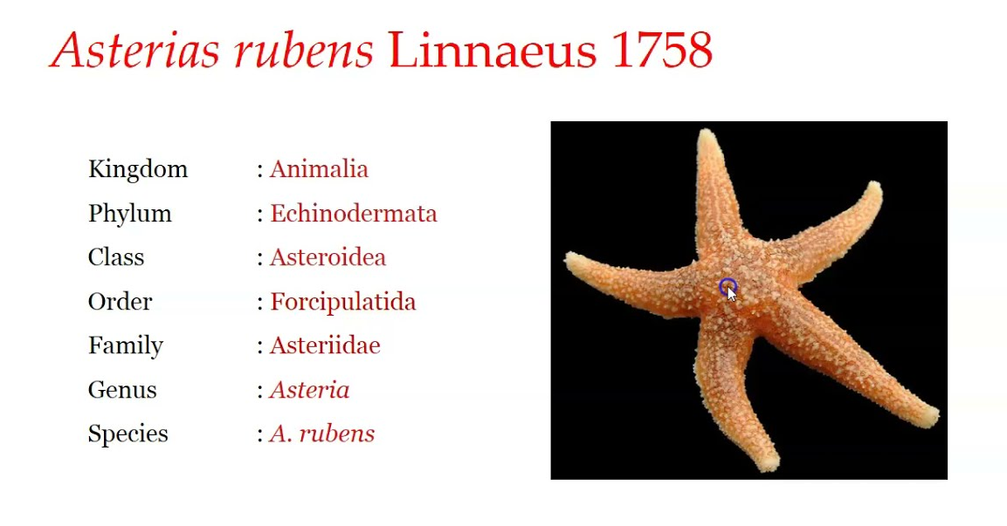

Slide 21
TAXONOMIC CHARACTERS AND RECONSTRUCTION OF PHYLOGENY
A taxonomic characteristic may be defined as any expressed attribute of an organism that can be evaluated and that has two or more discontinuous states or conditions. The taxonomic value of a characteristic is increased if the biological significance of the characteristic has been determined.
KINDS OF CHARECTERS
Morphological characters
Physiological characters
Ecological characters
Behavioral characters
Geographical characters
Molecular characters

Slide 22
Morphological characters
General external morphology
Special structures (e.g. genitalia)
Internal morphology (anatomy)
Embryology
Karyology and other cytological factors
Physiological characters
Metabolic factors
Body secretions
Genic sterility factors
Ecological characters
Habit and habitats
Food, Parasites and hosts
Seasonal variations
Behavioral characters
Courtship and other ethological isolating mechanisms
Other behavior patterns
Geographic characters
General biogeographic distribution patterns
Sympatric-allopatric relationship of populations
Molecular characters
Immunological distance
Electrophoretic differences
Amino acid sequences of proteins
DNA hybridization
DNA and RNA sequences
Restriction endonuclease analyses
Other molecular differences

Slide 23
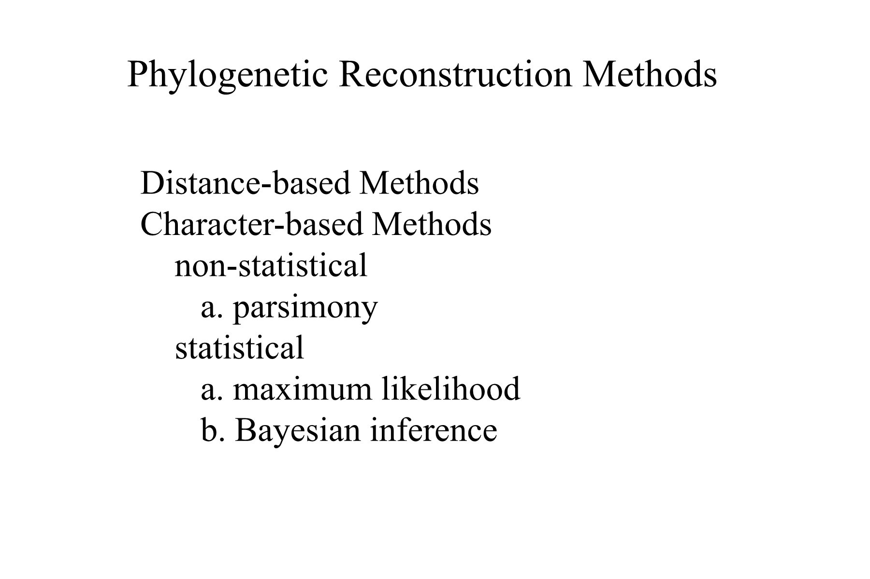
PHYLOGENY RECONSTRUCTION
A phylogeny is the evolutionary history of a group of entities. Given that this can only truly be known in exceptional circumstances, the main aim of phylogeny reconstruction is to describe evolutionary relationships in terms of relative recency of common ancestry. Four inference methods based on three optimization criteria are commonly used to reconstruct evolutionary history from molecular data: neighbor joining (NJ), minimum evolution (ME), maximum parsimony (MP), and maximum likelihood (ML).
Phylogenetics is important because it enriches our understanding of how genes, genomes, species (and molecular sequences more generally) evolve.

Slide 24
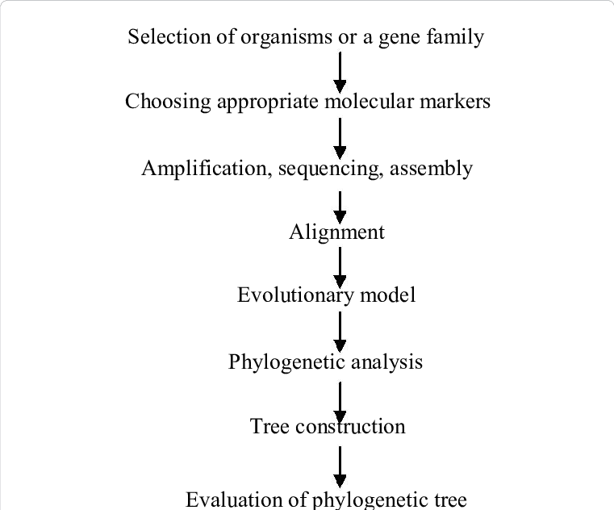
Distance-based methods
UPGMA (Unweighted Pair Group Method with Arithmetic mean)
Neighbor Joining
Fitch-Margoliash
Character-based methods
Maximum Parsimony
Maximum Likelihood (Probability-based)
Bayesian Inference (Probability-based)
STEPS

Slide 25
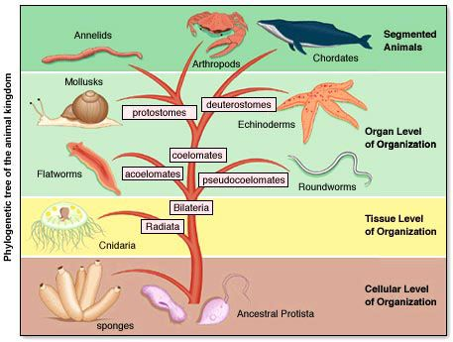
LEVEL OF ORGANIZATION
Levels of organization are structures in nature, usually defined by part-whole relationships, with things at higher levels being composed of things at the next lower level. An organism is made up of four levels of organization: cells, tissues, organs, and organ systems. These levels reduce complex anatomical structures into groups; this organization makes the components easier to understand.

Slide 26
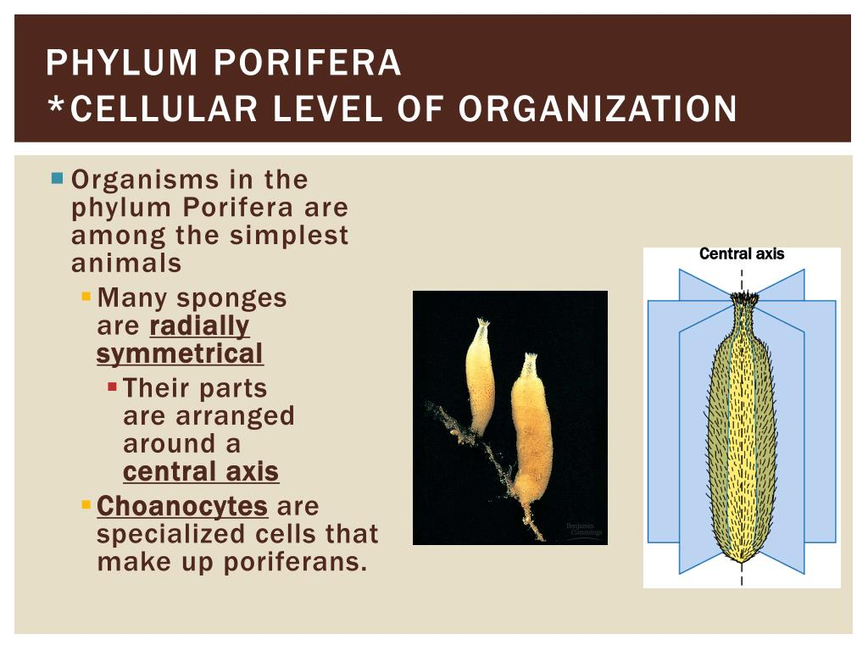
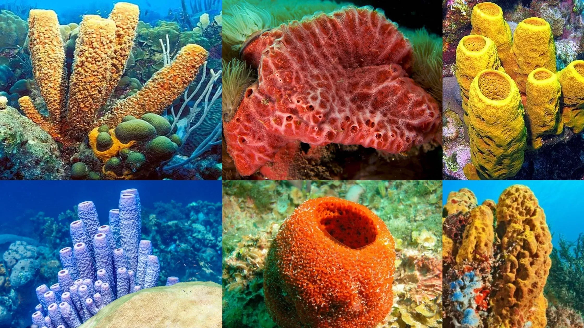
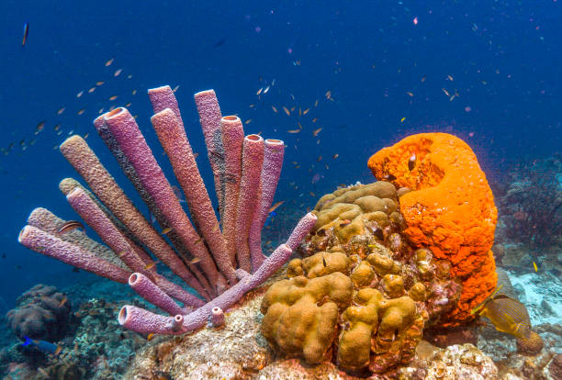
Cell level organization

Slide 27
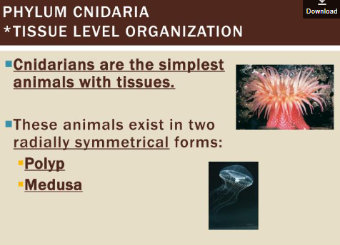
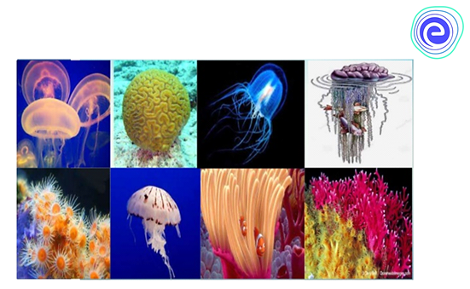
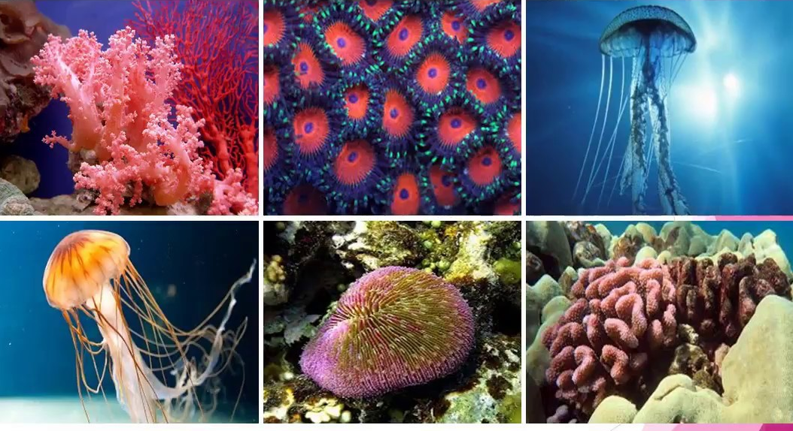
Tissue level organization

Slide 28
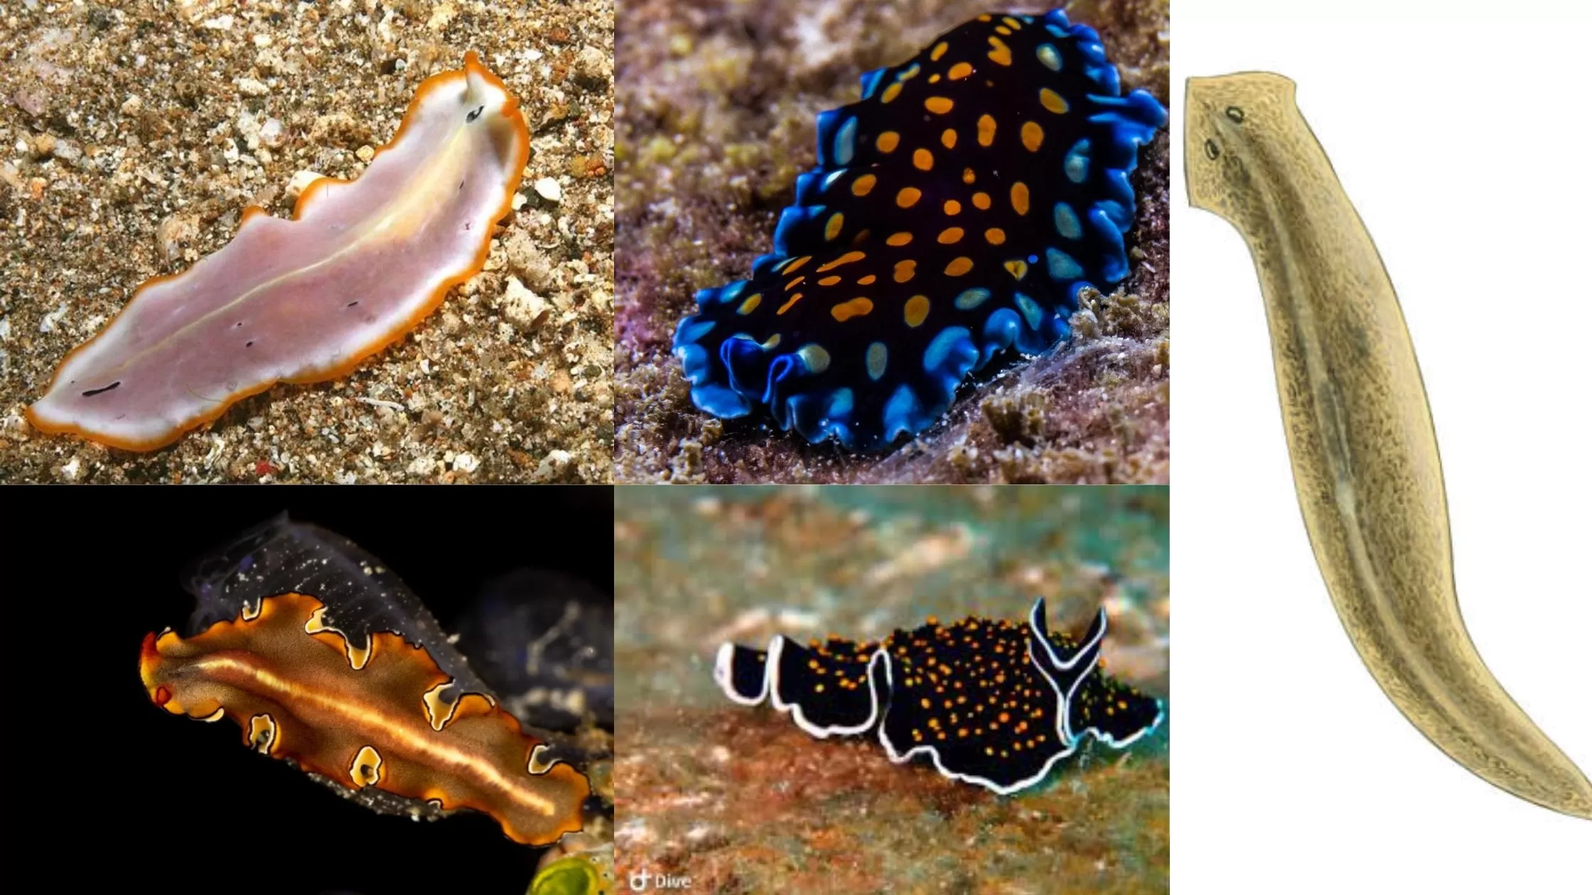
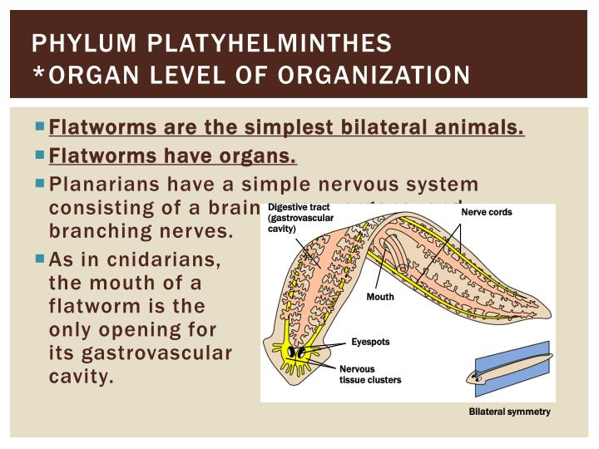
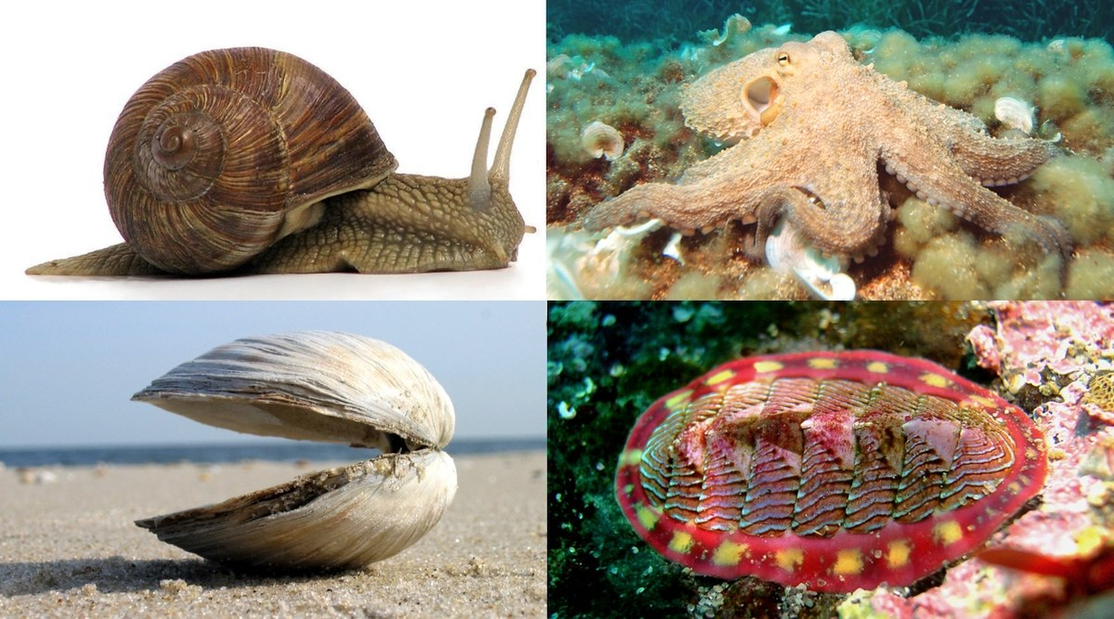
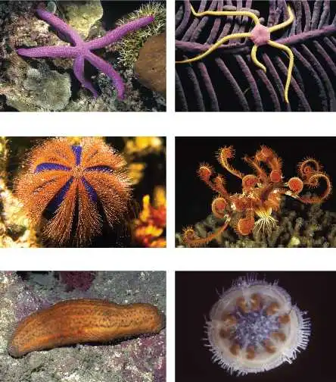
Organ level organization
Mollusca, Echinoderms and Platyhelminthes

Slide 29
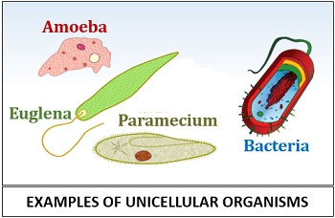
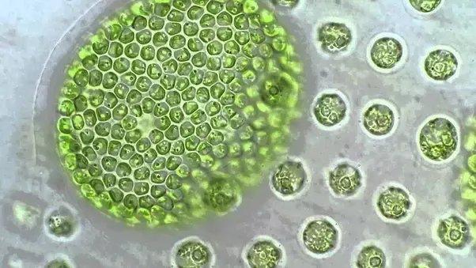
UNICELLULARITY
A condition or state in which an organism carries out all functions within one cell. These unicellular organisms are mostly invisible to the naked eye, hence, they are also referred to as microscopic organisms. Most of the unicellular organisms are also prokaryotes. Bacteria, amoeba, Paramecium, archaea, protozoa, unicellular algae, and unicellular fungi are examples.
MULTICELLULARITY
Multicellular organisms are composed of more than one cell, with groups of cells differentiating to take on specialized functions. They possess distinct organs and organ systems. They are eukaryotes including humans, animals, and plants.
COLONIZATION AND ORGANIZATION OF GERM LAYERS
The germ layers develop early in embryonic life, through the process of gastrulation. During gastrulation, a hollow cluster of cells called a blastula reorganizes into two primary germ layers: an inner layer, called endoderm, and an outer layer, called ectoderm.

Slide 30
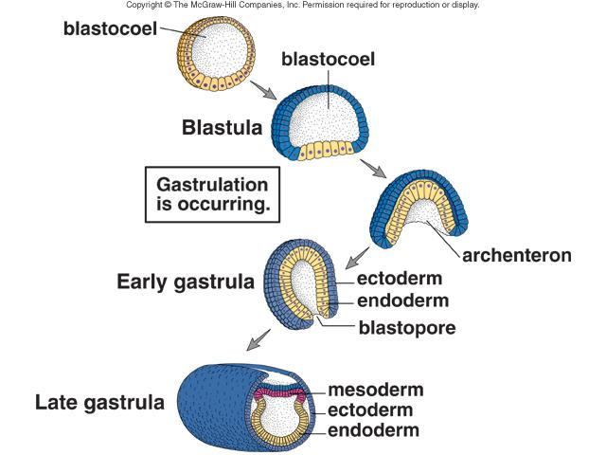
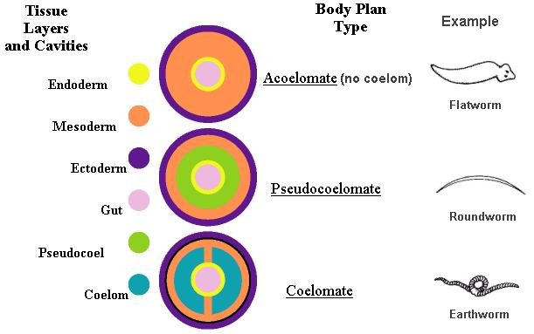
In all animals, except for organisms of the phylum Cnidaria, the endoderm and ectoderm interact to produce a third germ layer, called mesoderm

Slide 31
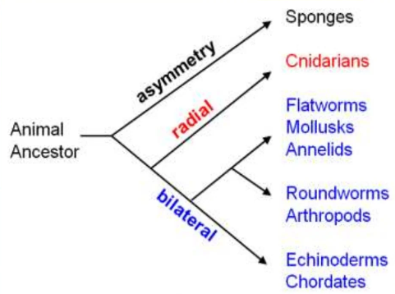
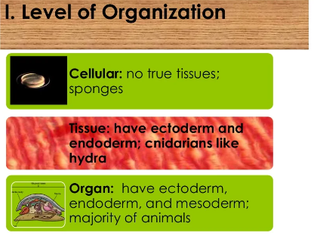
DIVISION OF LABOUR AND ORGANIZATION OF TISSUES
Division of labour is adaptation of different parts of an organism to carry out different functions. The complex tissues which are made up of different types of cells show good division of labour. The different cells in such tissues perform different functions and give the overall combined property to the tissue. Almost all cells specialized in performing related roles are classified together as tissues in the body.
ORGANIZATION OF TISSUES

Slide 32
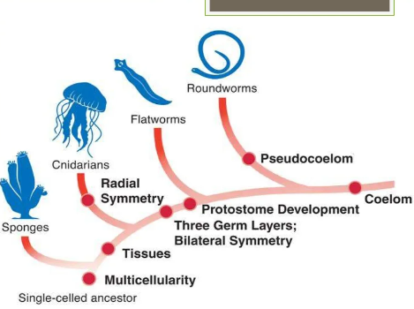
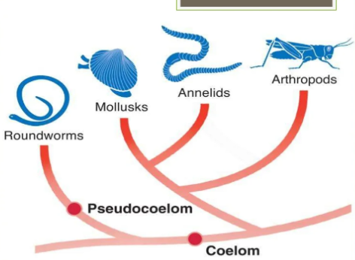

ORGANIZATION OF TISSUES

Slide 33



Slide 34


Slide 35



Slide 36


Slide 37

DEVELOPMENT OF COELOME AND ACOELOMATA

Slide 38



Slide 39


Slide 40



Slide 41



BODY SYMMETRY
Protozoan Radiolaria and Heliozoa.

Slide 42





Slide 43



Slide 44



Slide 45



SEGMENTATION AND CEPHALIZATION

